Slide 1
Association Rule Mining
CME 4416 – Introduction to Data Mining

Slide 2

Outline
What is Association Rule Mining?
Confidence and Support
Market Basket Analysis
Apriori Algorithm
Mining Association Rules
  Mining Single-Dimensional Association Rules
  Mining Multi-Dimensional Association Rules
  Mining Multi-Level Association Rules
FP- Trees

Slide 3


What is Association Rule Mining?
Association Rule Mining:
  Finding frequent patterns, associations, or correlations among sets of items or objects.
First proposed by Agrawal, Imielinski and Swami [AIS93]
Uncover relationships among data
Milk and
Diaper are
sold
together!

Slide 4
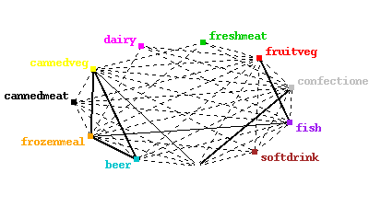
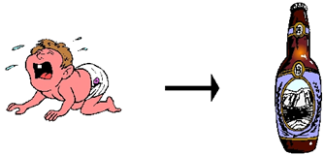
What is Association Rule Mining?
Given a set of records, produce dependency rules which will predict occurrence of an item based on occurrences of other items.
Example: When people buy diapers they also buy beer 60% of the time

Slide 5
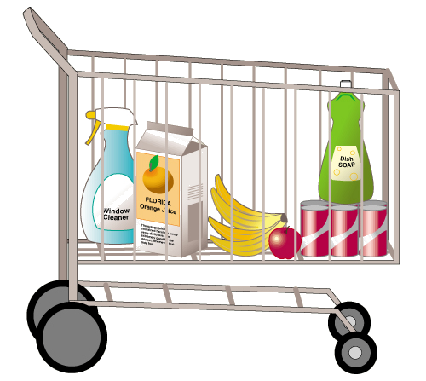
Association Rule Mining
POS Transactions
Co-occurrence of Products
Customer | Items Purchased
1 | OJ, soda
2 | Milk, OJ, window cleaner
3 | OJ
4 | OJ, detergent, soda
5 | Window cleaner, soda
 | OJ | Window cleaner | Milk | Soda | Detergent
OJ | 4 | 1 | 1 | 2 | 1
Window cleaner | 1 | 2 | 1 | 1 | 0
Milk | 1 | 1 | 1 | 0 | 0
Soda | 2 | 1 | 0 | 3 | 1
Detergent | 1 | 0 | 0 | 1 | 2
Simple patterns:
1. OJ and soda are more likely purchased together than any other two items
2. Detergent is never purchased with milk or window cleaner

Slide 6
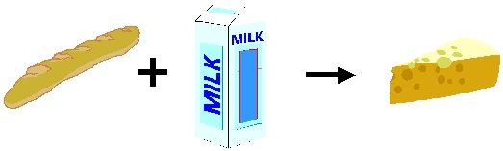
Association Rule Example 1
Example: 80% of customers who buy bread and milk also buy cheese, and 5% of customers buy all of them together
Bread, Milk→ Cheese [supp=5%, conf=80%]

Slide 7
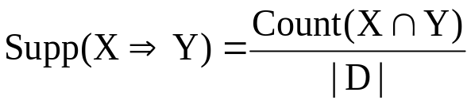
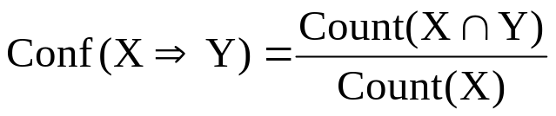
Confidence and Support
I = i₁, i₂, …, i_{m}: set of items
D : database of transactions
Association rule: X ⇒ Y
here X ⊂ I, Y ⊂ I and X ∩Y = ∅.
Rule X ⇒ Y has a confidence c in D
if c% of transactions in D that contain X also contain Y.
Rule X ⇒ Y has a support s in D
if s% of transactions in D contain X ∩ Y.
support ≥ minsup threshold
confidence ≥ minconf threshold

Slide 8
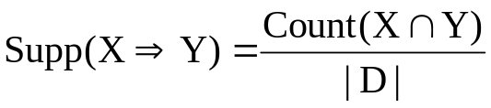
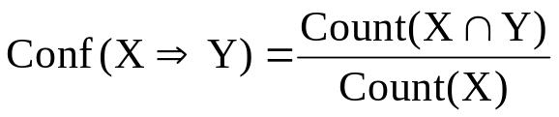
Confidence and Support
Support (s)
  Fraction of transactions that contain both X and Y
Confidence (c)
  Measures how often items in Y appear in transactions that contain X
Customer
buys both
Customer
buys diaper
Customer
buys beer

Slide 9
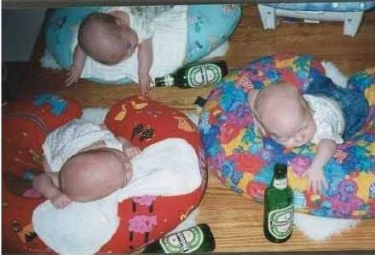
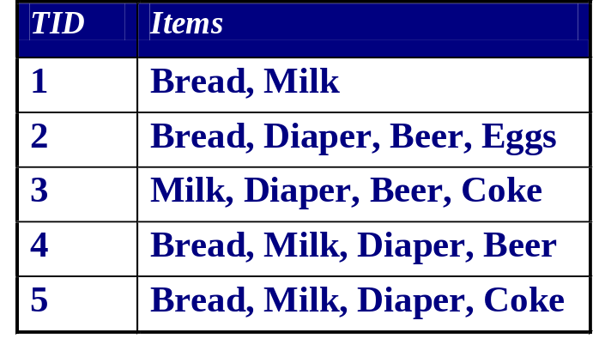
Association Rule Example 2
Diaper → Beer
Support =
Confidence =
#{Diaper, Beer} / Total # of record = 3/5
# {Diaper, Beer}/ # {Diaper} = 3/4

Slide 10
Association Rule Example 3
Rule form:
LHS → RHS [support, confidence]
Milk → Coke [60%,75%]
TID
Items
1
Bread, Coke, Milk
Rules Discovered:
{Milk} --> {Coke}
{Diaper, Milk} --> {Beer}
2
Beer, Bread
3
Beer, Coke, Diaper, Milk
4
Beer, Bread, Diaper, Milk
5
Coke, Diaper, Milk

Slide 11

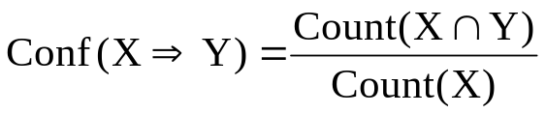
Association Rule Example 4
I: itemset
{cucumber, parsley, onion, tomato, salt, bread, olives, cheese, butter}
D: set of transactions
1 {{cucumber, parsley, onion, tomato, salt, bread},
2 {tomato, cucumber, parsley},
3 {tomato, cucumber, olives, onion, parsley},
4 {tomato, cucumber, onion, bread},
5 {tomato, salt, onion},
6 {bread, cheese}
7 {tomato, cheese, onion, cucumber}
8 {bread, butter}}
Supp(tomato ⇒ onion)
Conf(tomato ⇒ onion)
= 5 / 8 = 0.62 (62% of transactions in D contain X and Y
= 5 / 6 = 0.83 (83% of transactions in D contain X also
contain Y)

Slide 12
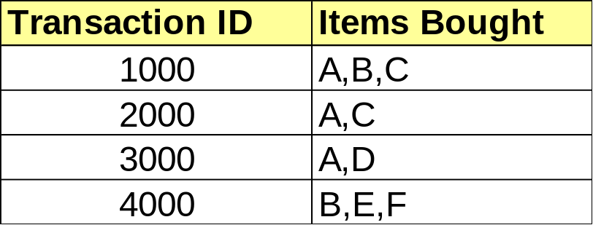
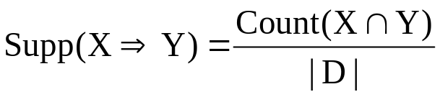

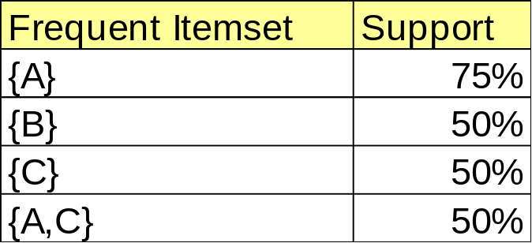
Association Rule Example 5
Database
  A ⇒ C
  C ⇒ A
(50%, 66.6%)
Min. support 50%
(50%, 100%)

Slide 13
Association Rule Example 6
Database
Find all relations which support 50% minimum support factor.
{bread}
{cucumber}
{onion}
{tomato}
{cucumber, onion}
{cucumber, tomato}
{onion, tomato}
{cucumber, onion, tomato}
TransID | Items
1 | cucumber, parsley, onion, tomato, salt, bread
2 | tomato, cucumber, parsley
3 | tomato, cucumber, olives, onion, parsley
4 | tomato, cucumber, onion, bread
5 | tomato, salt, onion
6 | bread, cheese
7 | tomato, cheese, onion, cucumber
8 | bread, butter
{bread}
{cucumber}
{onion}
{tomato}
{cucumber, onion}
{cucumber, tomato}
{onion, tomato}
{cucumber, onion, tomato}

Slide 14
Association Rule Example 7
Items={milk, coke, pepsi, beer, juice}.
Support = 3 baskets.
  B₁ = {m, c, b} B₂ = {m, p, j}
  B₃ = {m, b} B₄ = {c, j}
  B₅ = {m, p, b} B₆ = {m, c, b, j}
  B₇ = {c, b, j} B₈ = {b, c}
Frequent itemsets:
{m}, {c}, {b}, {j}, {m, b}, {c, b}, {j, c}.

Slide 15
Association Rule Example 8
  t1: Beef, Chicken, Milk
  t2: Beef, Cheese
  t3: Cheese, Boots
  t4: Beef, Chicken, Cheese
  t5: Beef, Chicken, Clothes, Cheese, Milk
  t6: Chicken, Clothes, Milk
  t7: Chicken, Milk, Clothes
Assume:
minsup = 30%
minconf = 80%
An example frequent itemset:
{Chicken, Clothes, Milk} [sup = 3/7]
Association rules from the itemset:
Clothes → Milk, Chicken [sup = 3/7, conf = 3/3]
Milk → Clothes, Chicken [sup = 3/7, conf = 3/4]
Chicken → Clothes, Milk [sup = 3/7, conf = 3/5]
… …
Clothes, Chicken → Milk [sup = 3/7, conf = 3/3]

Slide 16
Finding Association Rules
A user can ask for rules with minimum support minSup and minimum confidence minConf.
  Firstly, all frequent itemsets with support > minSup are computed.
  Secondly, rules are generated using the frequent itemsets, and checked for minConf.

Slide 17
The Apriori Algorithm
Input
The market base transaction dataset.
Process
  Determine large 1-itemsets.
  Repeat until no new large 1-itemsets are identified.
  Generate (k+1) length candidate itemsets from length k large itemsets.
  Prune candidate itemsets that are not large.
  Count the support of each candidate itemset.
  Eliminate candidate itemsets that are small.
Output
Itemsets that are “large” and qualify the min support and min confidence thresholds.
Pseudo-code:
    C_{k}: Candidate itemset of size k
    L_{k} : frequent itemset of size k
    L₁ = {frequent items};
    for (k = 1; L_{k} !=∅; k++) do begin
    C_{k+1} = candidates generated from L_{k};
    for each transaction t in database do
      increment the count of all candidates in C_{k+1}
      that are contained in t
    L_{k+1} = candidates in C_{k+1} with min_support
    end
    return ∪_{k} L_{k};

Slide 18

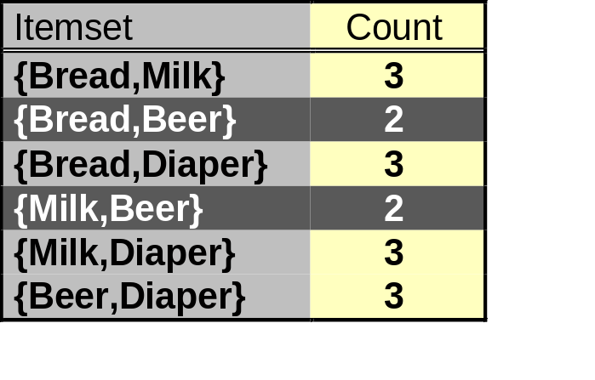
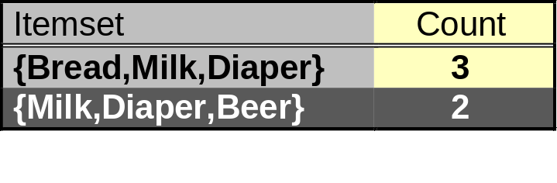
The Apriori Algorithm — Example
Items (1-itemsets)
Pairs (2-itemsets)
Minimum Support = 3
Triplets (3-itemsets)
If every subset is considered,
⁶C₁ + ⁶C₂ + ⁶C₃ = 41
With support-based pruning,
6 + 6 + 2 = 14

Slide 19
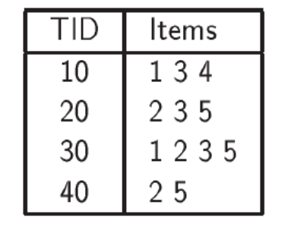
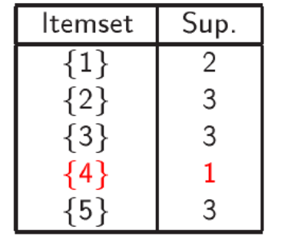
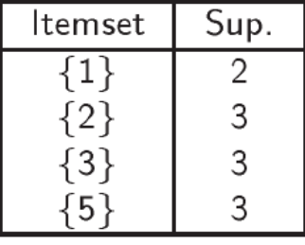
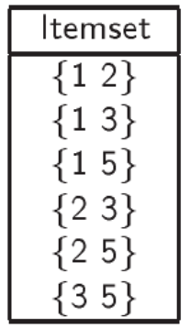
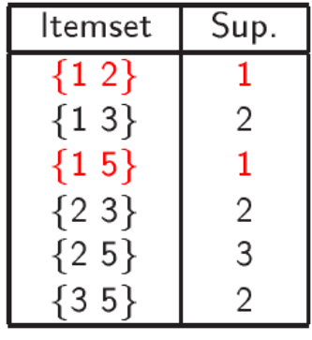
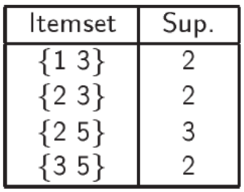
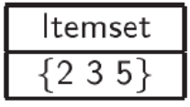


Apriori Example
1-itemset
Pruning
2-itemset
Pruning
3-itemset
Minimum Support : 2

Slide 20
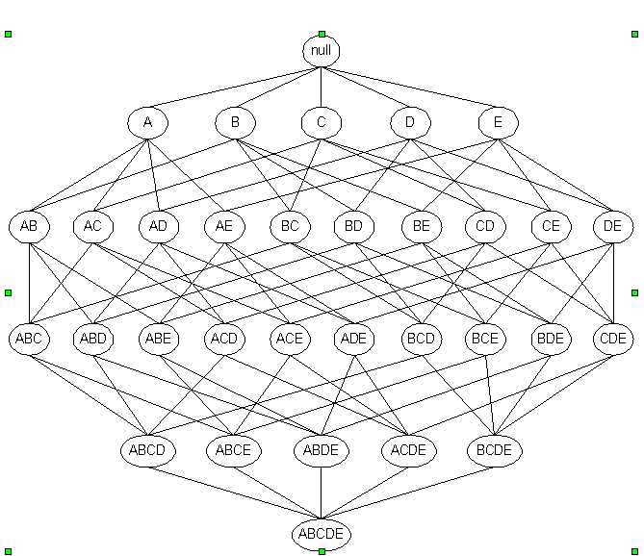
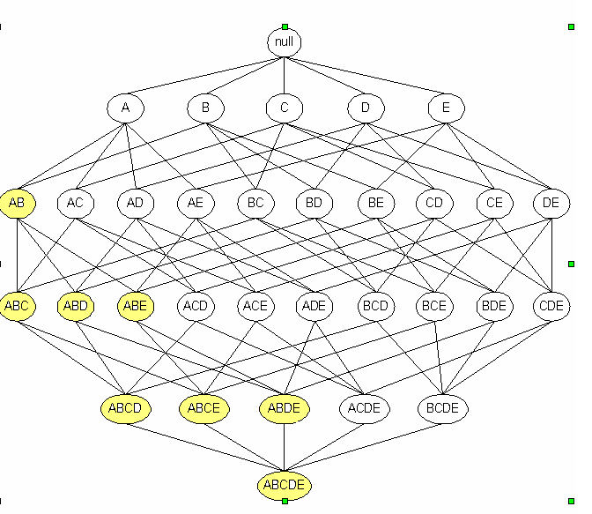
Apriori Principle
Apriori Principle: Candidate Pruning
If {a,b} is infrequent, then all it supersets are infrequent

Slide 21
Example of Candidate Generation
L₃={abc, abd, acd, ace, bcd}
Self-joining: L₃*L₃
  abcd from abc and abd
  acde from acd and ace
Pruning:
  acde is removed because ade is not in L₃
C₄={abcd}

Slide 22



Applications
Market Basket Analysis
  Input: Basket Data - Collection of records consisting of transaction identifier and the items bought in a transaction.
  Items: Products
  Goal: To identify items that are bought together
Supermarket Shelf Management
  For Example:
Many customers (%75) who buy diapers also buy beer on every Friday.
Moved the beer and snacks Increased sales on peanuts and
such as peanuts and pretzels → pretzels by more that 27%
next to the diapers

Slide 23
Applications
Text Mining
  Input: documents;
  Items: words in those documents
  Goal: Find words that appear together unusually frequently, i.e. linked concepts.
Web Mining
  Input: Web pages (a web page p)
  Items: Pages that link to p .
  Goal: Pages with many of the same links may be mirrors or about the same topic.
Healty and Drug Industry
  What kinds of DNA are sensitive to this new drug?
Other Applications
  Catalog design
  Promotion decision
  Genomic Data
  Customer Profiling

Slide 24
Single-Dimensional vs Multi-Dimensional
Single-Dimensional Rules:
  buys(X, “milk”) ⇒ buys(X, “bread”)
Multi-Dimensional rules:
≥ 2 dimensions or predicates
  age(x, “30..39”) ^ income(x, “42..48K”) → buys(x, “car”) [1%, 75%]
  Inter-dimension assoc. rules (no repeated predicates)
    age(X,”19-25”) ∧ occupation(X,“student”) ⇒ buys(X,“coke”)
  hybrid-dimension assoc. rules (repeated predicates)
    age(X,”19-25”) ∧ buys(X, “popcorn”) ⇒ buys(X, “coke”)

Slide 25
Multilevel Association Rules
all
computer
software
printer
computer
accessory
desktop
laptop
educational
financial
management
color
b/w
wrist pad
mouse
IBM
Dell
Sony
Toshiba
Microsoft
…
…
HP
…
Sony
…
Ergoway
Logitech

Slide 26
Multilevel Association Rules
Replace items/concepts at level k with the concepts at level k-1
Apply an Association Rules Algorithm at the items at level k-1
Level 3 Level 2
TID | Items Purchased
T1 | IBM desktop computer, Sony b/w printer
T2 | Microsoft educational software, Microsoft financial software
T3 | Logitech mouse, Microsoft financial software
T4 | IBM desktop computer, Microsoft financial software
T5 | IBM desktop computer
T6 | …
TID | Items Purchased
T1 | desktop computer, b/w printer
T2 | educational software, financial software
T3 | mouse, financial software
T4 | desktop computer, financial software
T5 | desktop computer
T6 | …
computer
desktop
laptop
IBM
Dell
Sony
Toshiba
desktop computer → b/w printer [support=8%, confidence = 70%] (R1)
IBM desktop computer → Sony b/w printer [support=2%, confidence=72%] (R2)

Slide 27
Performance Bottlenecks of Apriori
Bottlenecks of Apriori: candidate generation
  Generate huge candidate sets:
    10⁴ frequent 1-itemset will generate 10⁷ candidate 2-itemsets
    To discover a frequent pattern of size 100, e.g., {a₁, a₂, …, a₁₀₀}, one needs to generate 2¹⁰⁰ ≈ 10³⁰ candidates.
  Candidate Test incur multiple scans of database: each candidate
Mining Frequent Patterns without Candidate Generation (SIGMOD2000)

Slide 28
Overview of FP-Growth: Ideas
Compress a large database into a compact, Frequent-Pattern tree (FP-tree) structure
  highly compacted, but complete for frequent pattern mining
  avoid costly repeated database scans
Develop an efficient, FP-tree-based frequent pattern mining method (FP-growth)
  A divide-and-conquer methodology: decompose mining tasks into smaller ones
  Avoid candidate generation: sub-database test only.
Mining Frequent Patterns without Candidate Generation (SIGMOD2000))

Slide 29
Construct FP-tree
Two Steps:
Scan the transaction DB for the first time, find frequent items (single item patterns) and order them into a list L in frequency descending order.
e.g., L={f:4, c:4, a:3, b:3, m:3, p:3}
In the format of (item-name, support)
2. For each transaction, order its frequent items according to the order in L; Scan DB the second time, construct FP-tree by putting each frequency ordered transaction onto it.
Mining Frequent Patterns without Candidate Generation (SIGMOD2000)

Slide 30
FP-tree Example: step 1
Step 1: Scan DB for the first time to generate L
L
TID Items bought
100 {f, a, c, d, g, i, m, p}
200 {a, b, c, f, l, m, o}
300 {b, f, h, j, o}
400 {b, c, k, s, p}
500 {a, f, c, e, l, p, m, n}
Item frequency
f 4
c 4
a 3
b 3
m 3
p 3
By-Product of First Scan of Database
Mining Frequent Patterns without Candidate Generation (SIGMOD2000)

Slide 31
FP-tree Example: step 2
Step 2: scan the DB for the second time, order frequent items in each transaction
TID Items bought (ordered) frequent items
100 {f, a, c, d, g, i, m, p} {f, c, a, m, p}
200 {a, b, c, f, l, m, o} {f, c, a, b, m}
300 {b, f, h, j, o} {f, b}
400 {b, c, k, s, p} {c, b, p}
500 {a, f, c, e, l, p, m, n} {f, c, a, m, p}
Mining Frequent Patterns without Candidate Generation (SIGMOD2000)

Slide 32
FP-tree Example: step 2
Step 2: construct FP-tree
{}
{}
f:1
f:2
{f, c, a, m, p}
{f, c, a, b, m}
{}
c:1
c:2
a:1
a:2
m:1
m:1
b:1
NOTE: Each transaction corresponds to one path in the FP-tree
p:1
p:1
m:1
Mining Frequent Patterns without Candidate Generation (SIGMOD2000)

Slide 33
FP-tree Example: step 2
Step 2: construct FP-tree
{}
{}
{}
f:3
f:3
c:1
f:4
c:1
{f, b}
{c, b, p}
{f, c, a, m, p}
c:2
b:1
c:2
b:1
b:1
c:3
b:1
b:1
a:2
a:2
p:1
a:3
p:1
m:1
b:1
m:1
b:1
m:2
b:1
p:1
m:1
p:1
m:1
p:2
m:1
Node-Link
Mining Frequent Patterns without Candidate Generation (SIGMOD2000)

Slide 34
Construction Example
Final FP-tree
{}
Header Table
Item head
f
c
a
b
m
p
f:4
c:1
c:3
b:1
b:1
a:3
p:1
m:2
b:1
p:2
m:1
Mining Frequent Patterns without Candidate Generation (SIGMOD2000)

Slide 35
FP-Tree Definition
FP-tree is a frequent pattern tree . Formally, FP-tree is a tree structure defined below:
1. One root labeled as “null", a set of item prefix sub-trees as the children of the root, and a frequent-item header table.
2. Each node in the item prefix sub-trees has three fields:
  item-name : register which item this node represents,
  count, the number of transactions represented by the portion of the path reaching this node,
  node-link that links to the next node in the FP-tree carrying the same item-name, or null if there is none.
3. Each entry in the frequent-item header table has two fields,
  item-name, and
  head of node-link that points to the first node in the FP-tree carrying the item-name.
Mining Frequent Patterns without Candidate Generation (SIGMOD2000)

Slide 36
Advantages of the FP-tree Structure
The most significant advantage of the FP-tree
  Scan the DB only twice and twice only.
Completeness:
  the FP-tree contains all the information related to mining frequent patterns (given the min-support threshold). Why?
Compactness:
  The size of the tree is bounded by the occurrences of frequent items
  The height of the tree is bounded by the maximum number of items in a transaction
Mining Frequent Patterns without Candidate Generation (SIGMOD2000)

Slide 37
Questions?
Why descending order?
Example 1:
{}
f:1
a:1
TID (unordered) frequent items
100 {f, a, c, m, p}
500 {a, f, c, p, m}
a:1
f:1
c:1
c:1
m:1
p:1
p:1
m:1
Mining Frequent Patterns without Candidate Generation (SIGMOD2000)

Slide 38
Questions?
Example 2:
{}
TID (ascended) frequent items
100 {p, m, a, c, f}
200 {m, b, a, c, f}
300 {b, f}
400 {p, b, c}
500 {p, m, a, c, f}
p:3
m:2
c:1
m:2
b:1
b:1
b:1
a:2
c:1
a:2
p:1
This tree is larger than FP-tree, because in FP-tree, more frequent items have a higher position, which makes branches less
c:2
c:1
f:2
f:2
Mining Frequent Patterns without Candidate Generation (SIGMOD2000)

Slide 39
Mining Frequent Patterns Using FP-tree
General idea (divide-and-conquer)
Recursively grow frequent patterns using the FP-tree: looking for shorter ones recursively and then concatenating the suffix:
  For each frequent item, construct its conditional pattern base, and then its conditional FP-tree;
  Repeat the process on each newly created conditional FP-tree until the resulting FP-tree is empty, or it contains only one path (single path will generate all the combinations of its sub-paths, each of which is a frequent pattern)
Mining Frequent Patterns without Candidate Generation (SIGMOD2000)

Slide 40
3 Major Steps
Starting the processing from the end of list L:
Step 1:
  Construct conditional pattern base for each item in the header table
Step 2
  Construct conditional FP-tree from each conditional pattern base
Step 3
  Recursively mine conditional FP-trees and grow frequent patterns obtained so far. If the conditional FP-tree contains a single path, simply enumerate all the patterns
Mining Frequent Patterns without Candidate Generation (SIGMOD2000)

Slide 41
Step 1: Construct Conditional Pattern Base
Starting at the bottom of frequent-item header table in the FP-tree
Traverse the FP-tree by following the link of each frequent item
Accumulate all of transformed prefix paths of that item to form a conditional pattern base
{}
Conditional pattern bases
item cond. pattern base
p fcam:2, cb:1
m fca:2, fcab:1
b fca:1, f:1, c:1
a fc:3
c f:3
f { }
Header Table
Item head
f
c
a
b
m
p
f:4
c:1
c:3
b:1
b:1
a:3
p:1
m:2
b:1
p:2
m:1
Mining Frequent Patterns without Candidate Generation (SIGMOD2000)

Slide 42
Properties of FP-Tree
Node-link property
  For any frequent item a_{i}, all the possible frequent patterns that contain a_{i} can be obtained by following a_{i}'s node-links, starting from a_{i}'s head in the FP-tree header.
Prefix path property
  To calculate the frequent patterns for a node a_{i} in a path P, only the prefix sub-path of a_{i} in P need to be accumulated, and its frequency count should carry the same count as node a_{i}.
Mining Frequent Patterns without Candidate Generation (SIGMOD2000)

Slide 43
Step 2: Construct Conditional FP-tree
For each pattern base
  Accumulate the count for each item in the base
  Construct the conditional FP-tree for the frequent items of the pattern base
{}
Header Table
Item head
f 4
c 4
a 3
b 3
m 3
p 3
f:4
{}
c:3
f:3
m- cond. pattern base:
  fca:2, fcab:1
a:3


c:3
m:2
b:1
a:3
m:1
m-conditional FP-tree
Mining Frequent Patterns without Candidate Generation (SIGMOD2000)

Slide 44
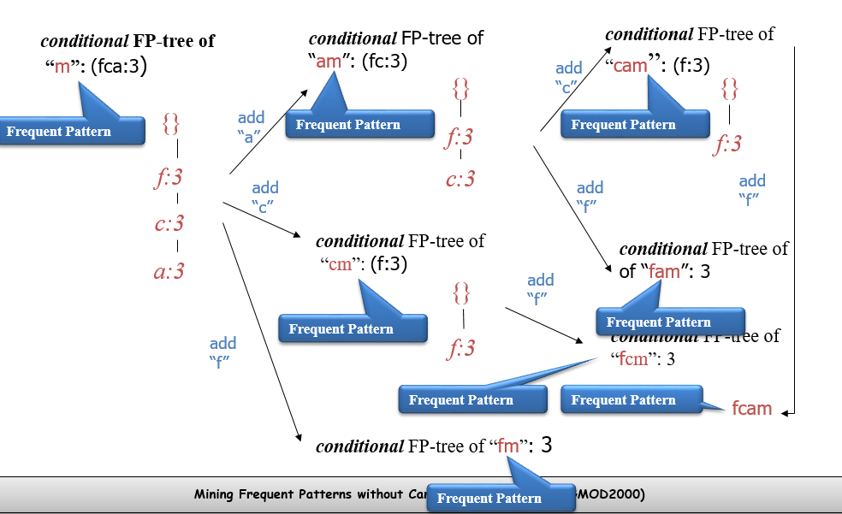

Step 3: Recursively mine the conditional FP-tree

Slide 45
Principles of FP-Growth
Pattern growth property
  Let α be a frequent itemset in DB, B be α's conditional pattern base, and β be an itemset in B. Then α ∪ β is a frequent itemset in DB iff β is frequent in B.
Is “fcabm ” a frequent pattern?
  “fcab” is a branch of m's conditional pattern base
  “b” is NOT frequent in transactions containing “fcab ”
  “bm” is NOT a frequent itemset.
Mining Frequent Patterns without Candidate Generation (SIGMOD2000)

Slide 46
Conditional Pattern Bases and
Conditional FP-Tree
Item
Conditional pattern base
Conditional FP-tree
p
{(fcam:2), (cb:1)}
{(c:3)}|p
m
{(fca:2), (fcab:1)}
{(f:3, c:3, a:3)}|m
b
{(fca:1), (f:1), (c:1)}
Empty
a
{(fc:3)}
{(f:3, c:3)}|a
c
{(f:3)}
{(f:3)}|c
f
Empty
Empty
order of L
Mining Frequent Patterns without Candidate Generation (SIGMOD2000)

Slide 47
Single FP-tree Path Generation
Suppose an FP-tree T has a single path P. The complete set of frequent pattern of T can be generated by enumeration of all the combinations of the sub-paths of P
{}
All frequent patterns concerning m: combination of {f, c, a} and m
m,
fm, cm, am,
fcm, fam, cam,
fcam
f:3

c:3
a:3
m-conditional FP-tree
Mining Frequent Patterns without Candidate Generation (SIGMOD2000)

Slide 48
Slides are acknowledged from:
Asst. Prof. Dr. Derya BİRANT and
Jiawei Han, Jian Pei and Yiwen Yin School of Computer Science Simon Fraser University

